Slide 1
















IKIGAI I-CARE
Presented by
Mavra Mehak, Maryum Tanvir, Salman Khan

Slide 2

Origin of the creative idea
Clinics generate massive amounts of data, from patient records to booking appointments and shift scheduling. Many clinics still rely on traditional manual systems to handle different functions, which can lead to errors, inefficiencies and inconsistencies. These problems affect the quality of patient care, delay treatments, and increase costs.
I-CARE addresses these challenges by offering a comprehensive, centralized platform that unifies all clinic appointment management functions under one digital solution.

Slide 3
Reduce manual work and paperwork, allowing doctors to focus on patient care. This will result in more time efficient services and less human error.
01.
Project vision and mission
A user-friendly scheduling system that efficiently manages doctors ensuring no gaps or delays in patient care with appointment management.
02.
Clinic Appointment management system includes doctor management, appointment management and prescription assignment to the patient. After researching and discussing we decided that rather than focusing on only one aspect of Appointment Management, We should make a system that would facilitate patients, doctors and admins.
Unified data storage across departments enables better decision-making, giving administrators, doctors and patients access to up-to- records.
03.

Slide 4
Architecture

Slide 5
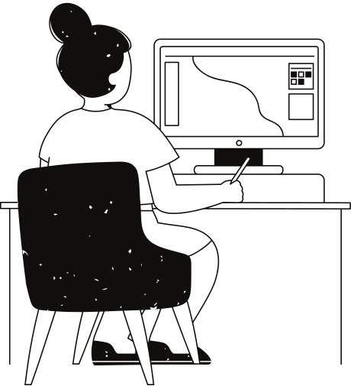
MVC Architecture
Models: Define MongoDB schemas for Users, Admin, Doctor, Patient, Appointments, Shifts, etc.
Controllers: Implement logic like approving doctors, checking appointment status before deletion, etc.
Views: Frontend pages that show data to each user role using API responses

Slide 6
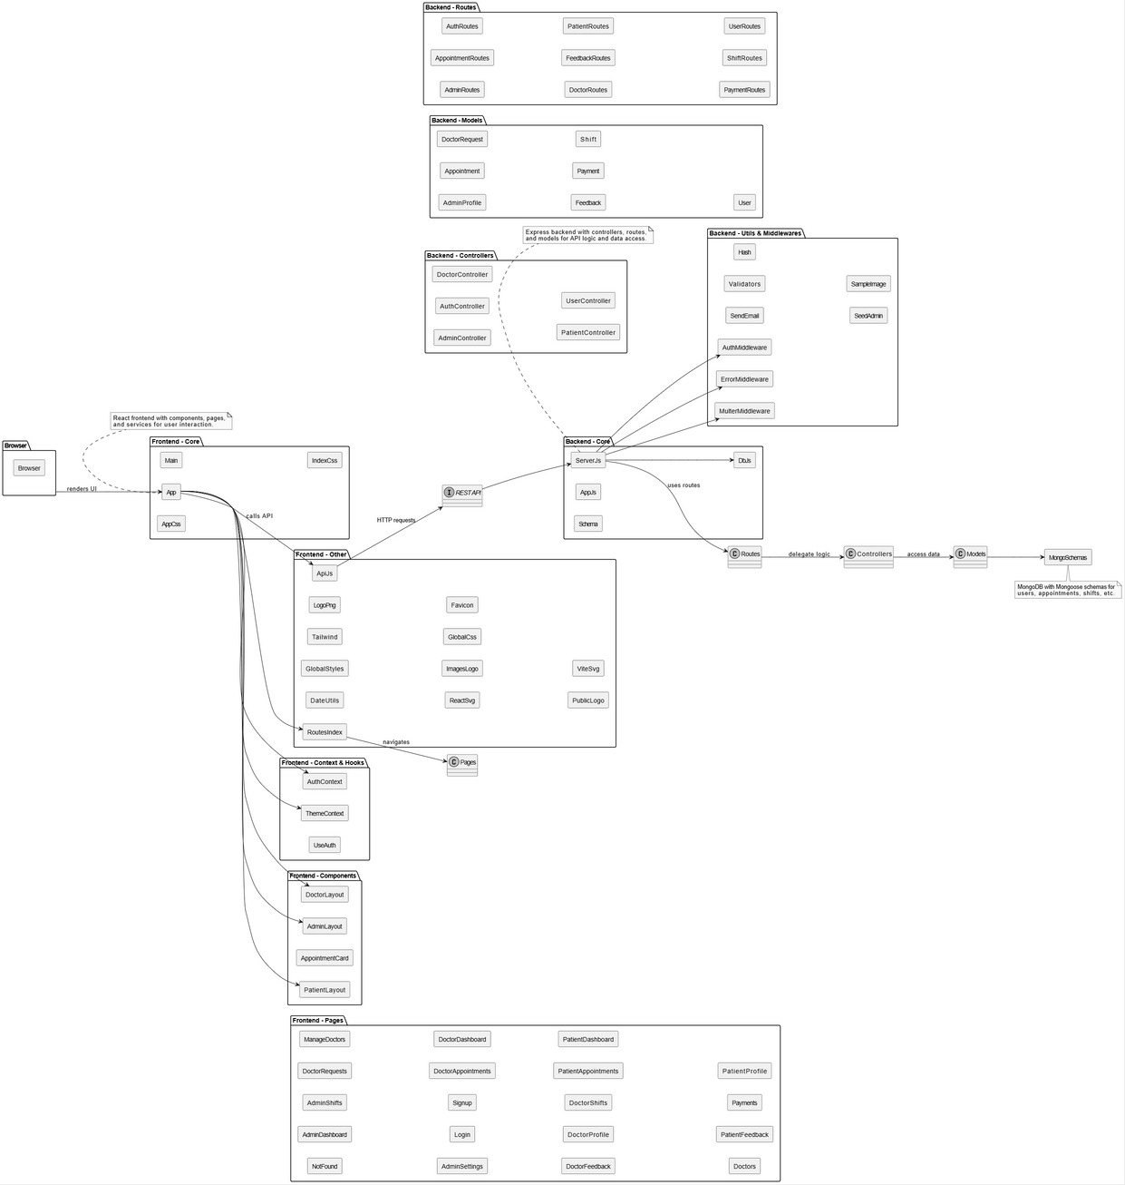

Package Diagram

Slide 7
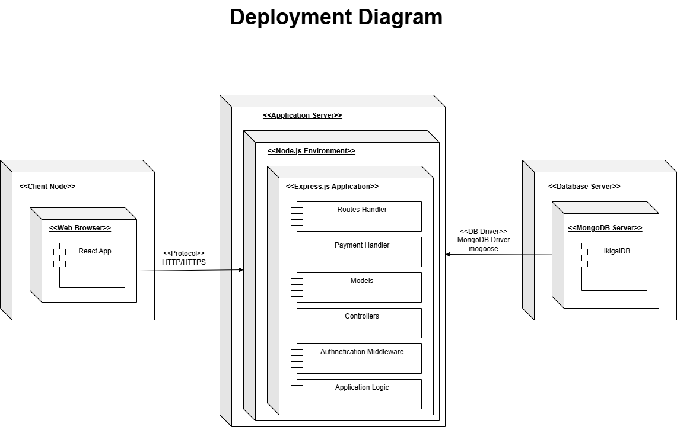
Deployment Diagram

Slide 8
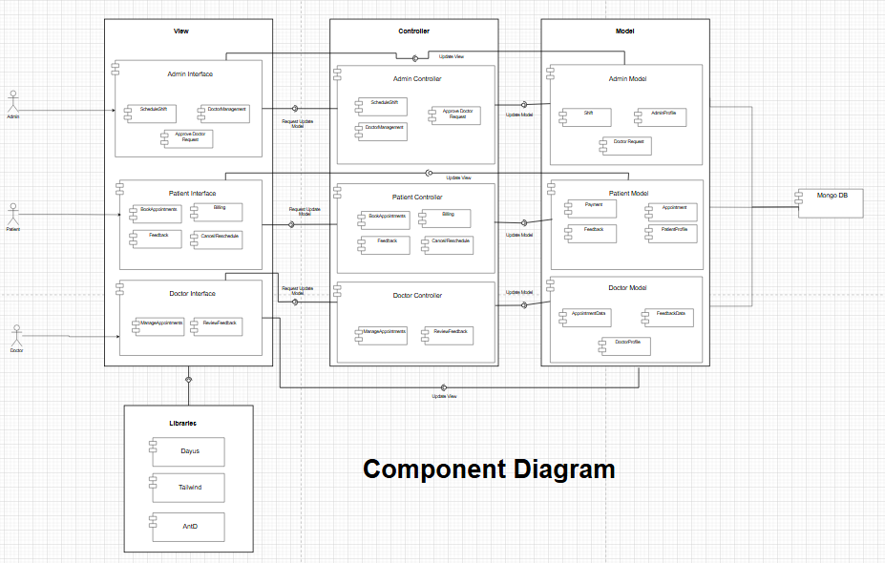
Component Diagram

Slide 9
Main Success Scenario
01
02
03
04
The patient opens the Appointments form. They select the doctor and a date they want to schedule an appointment along with a brief description.
The System checks if the doctor’s schedule allows for another Appointment to be made. If it’s available it shows all the details before confirmation.
The patient can overview the details. Once they are satisfied, they can schedule the appointment by pressing the Book Button.
The appointment is successfully scheduled, and logged into the database.
Alternative for 2: If the doctor’s schedule is already full, it informs the patient to select another doctor.

Slide 10
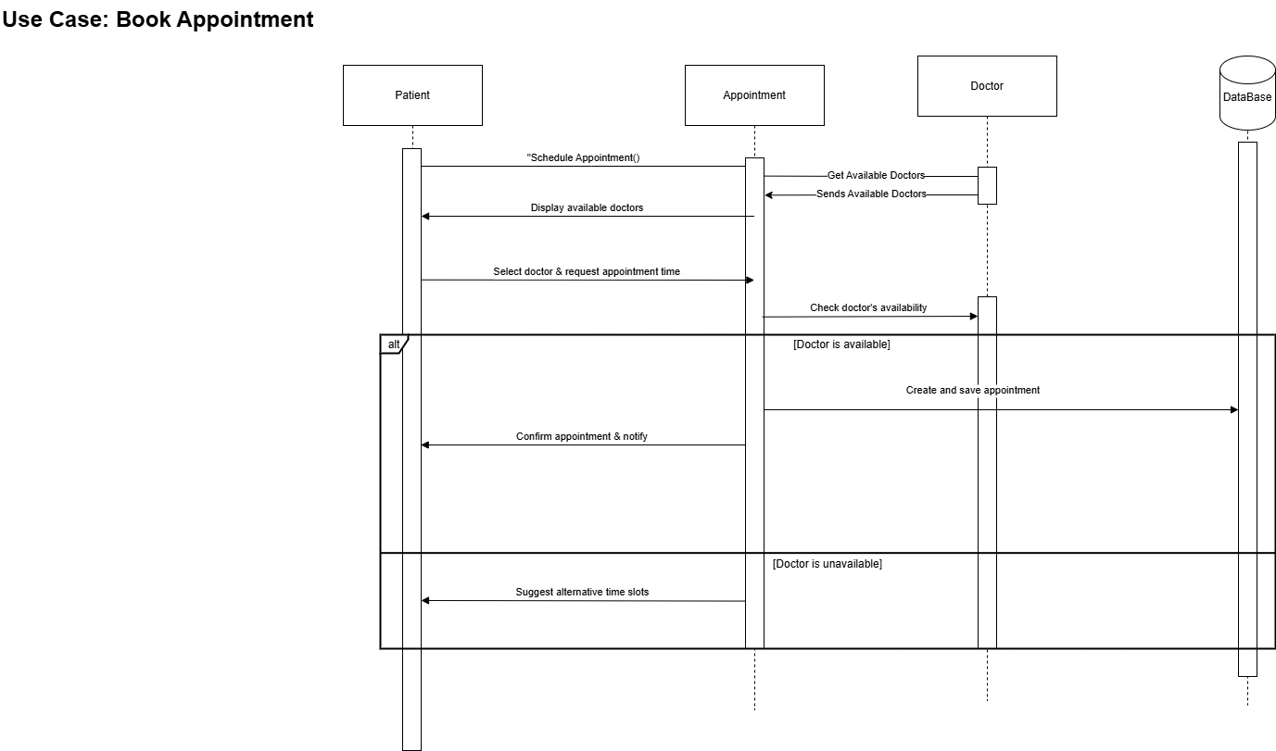
Book Appointment Sequence Diagram (main use case)

Slide 11
Project Planner

Slide 12
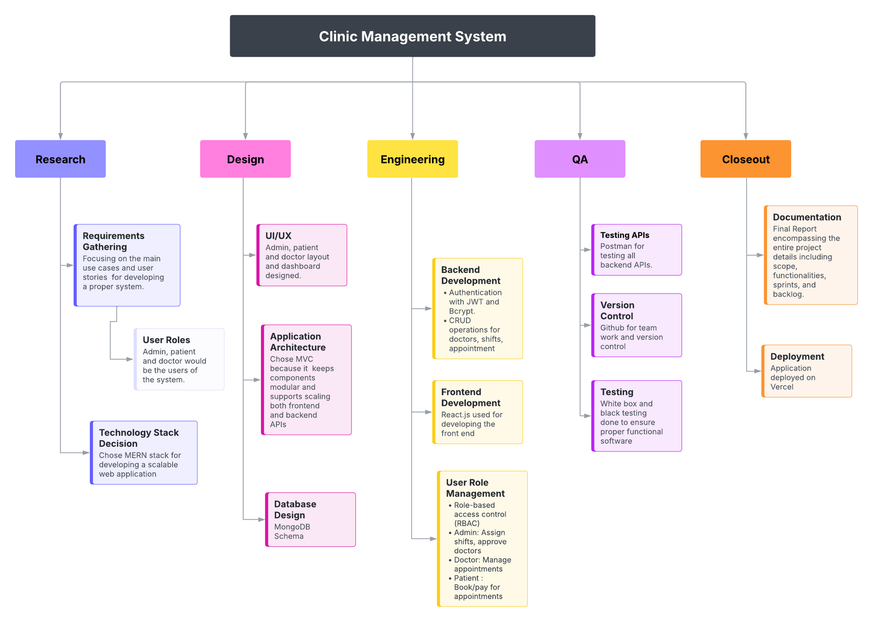
Work Breakdown Structure

Slide 13
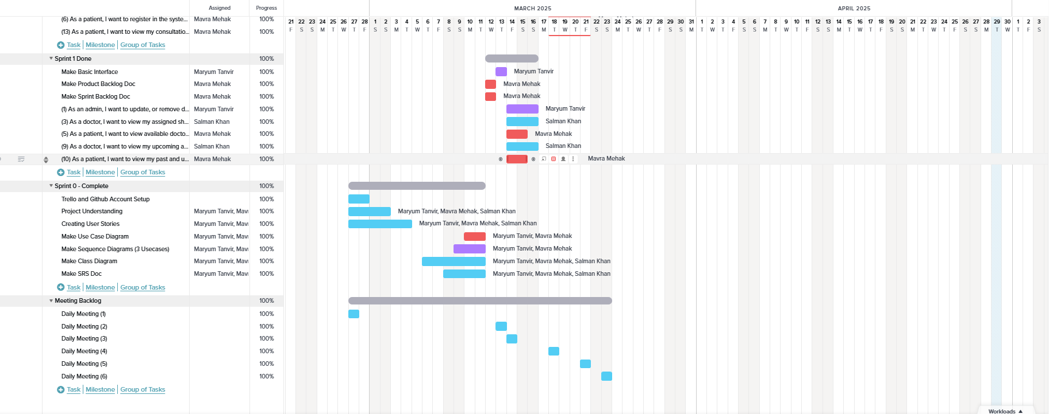
Gantt Chart

Slide 14
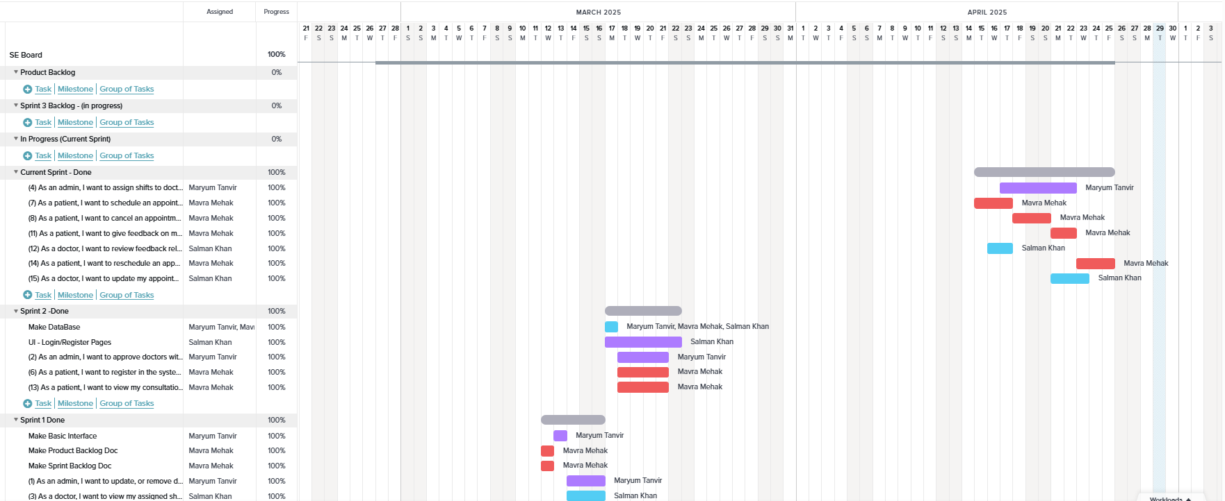
Gantt Chart

Slide 15
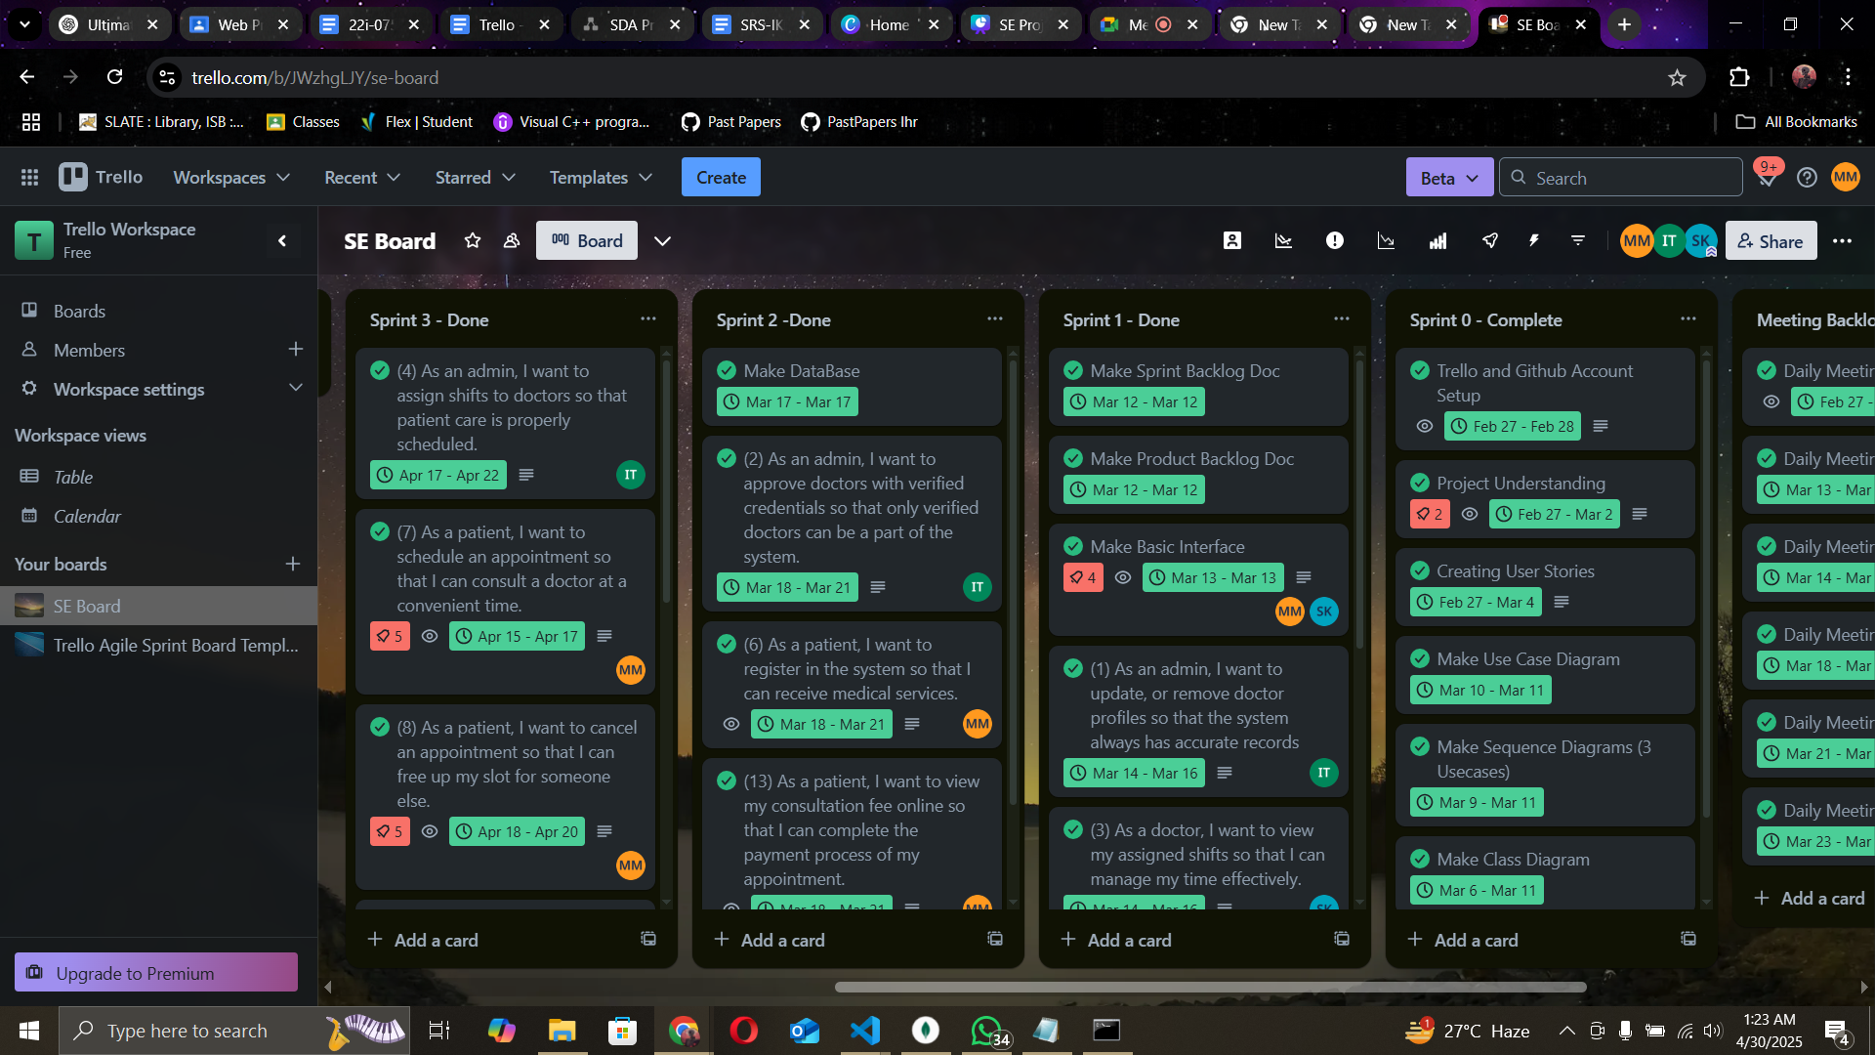
Sprint Planning

Slide 16
User Stories

Slide 17
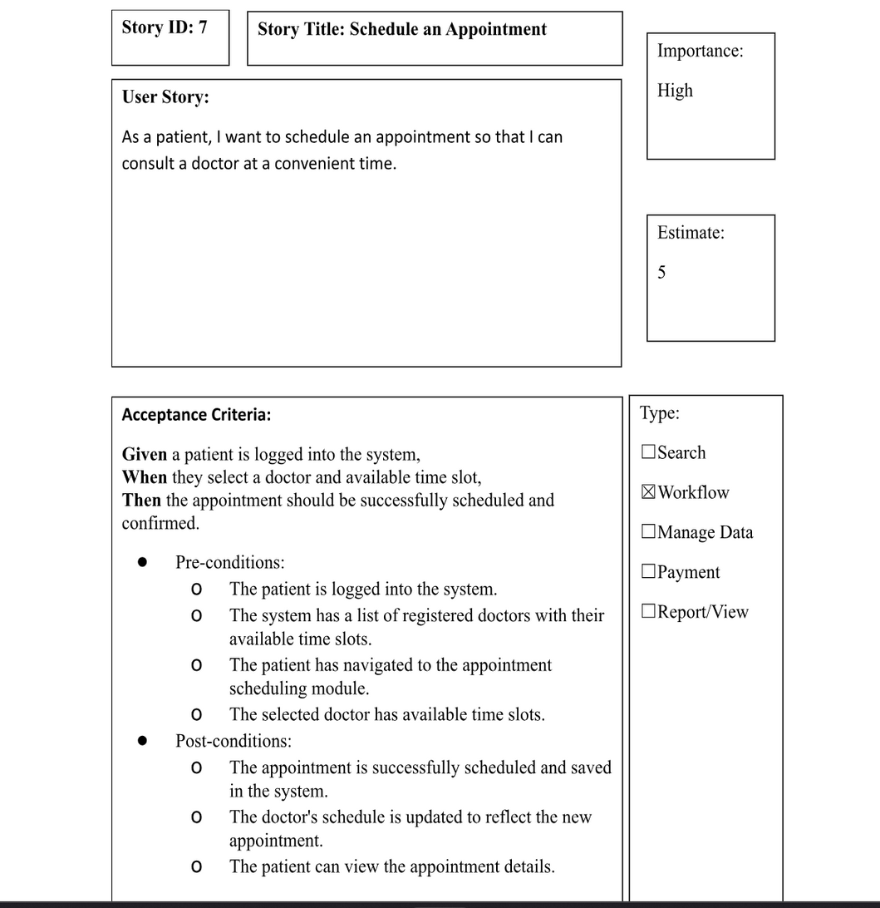
Schedule Appointment

Slide 18
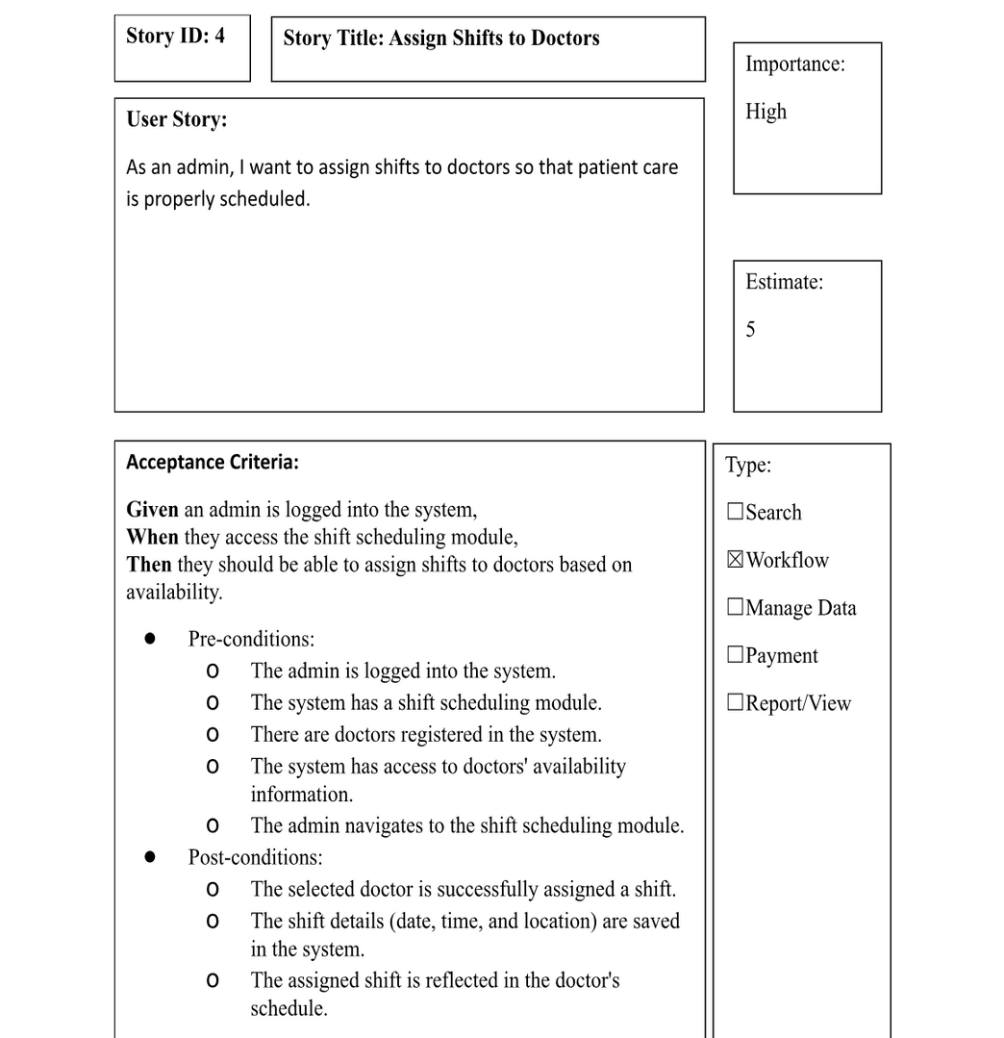
Assign Shifts

Slide 19
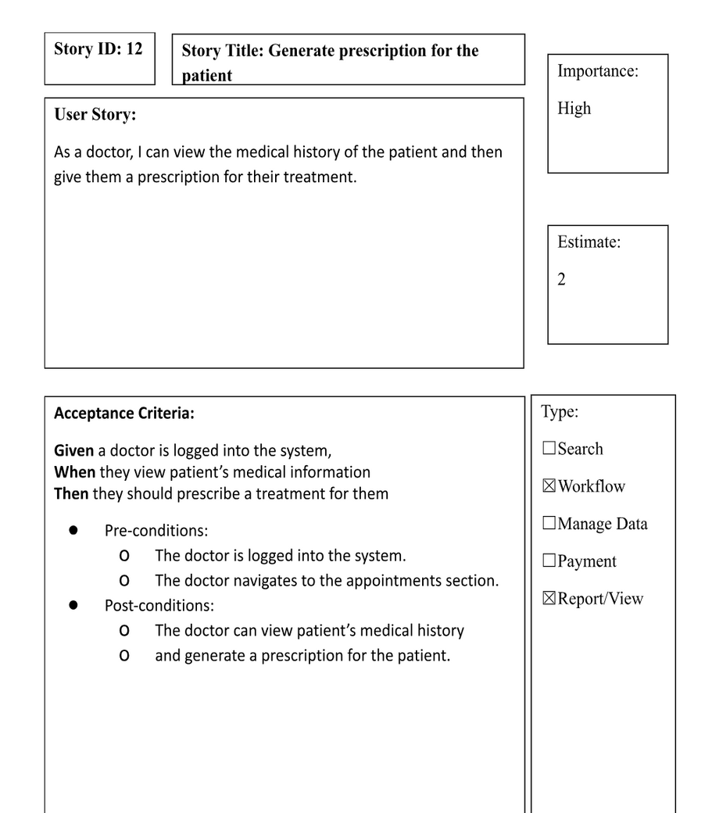
Generate Prescription

Slide 20
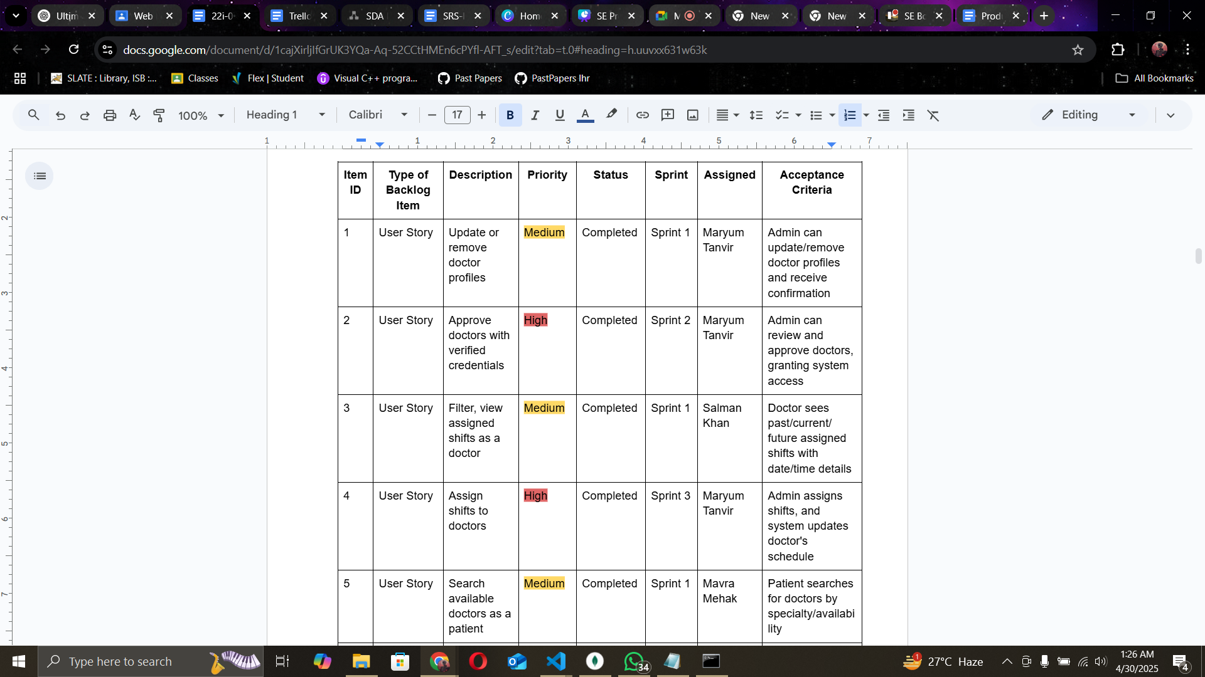
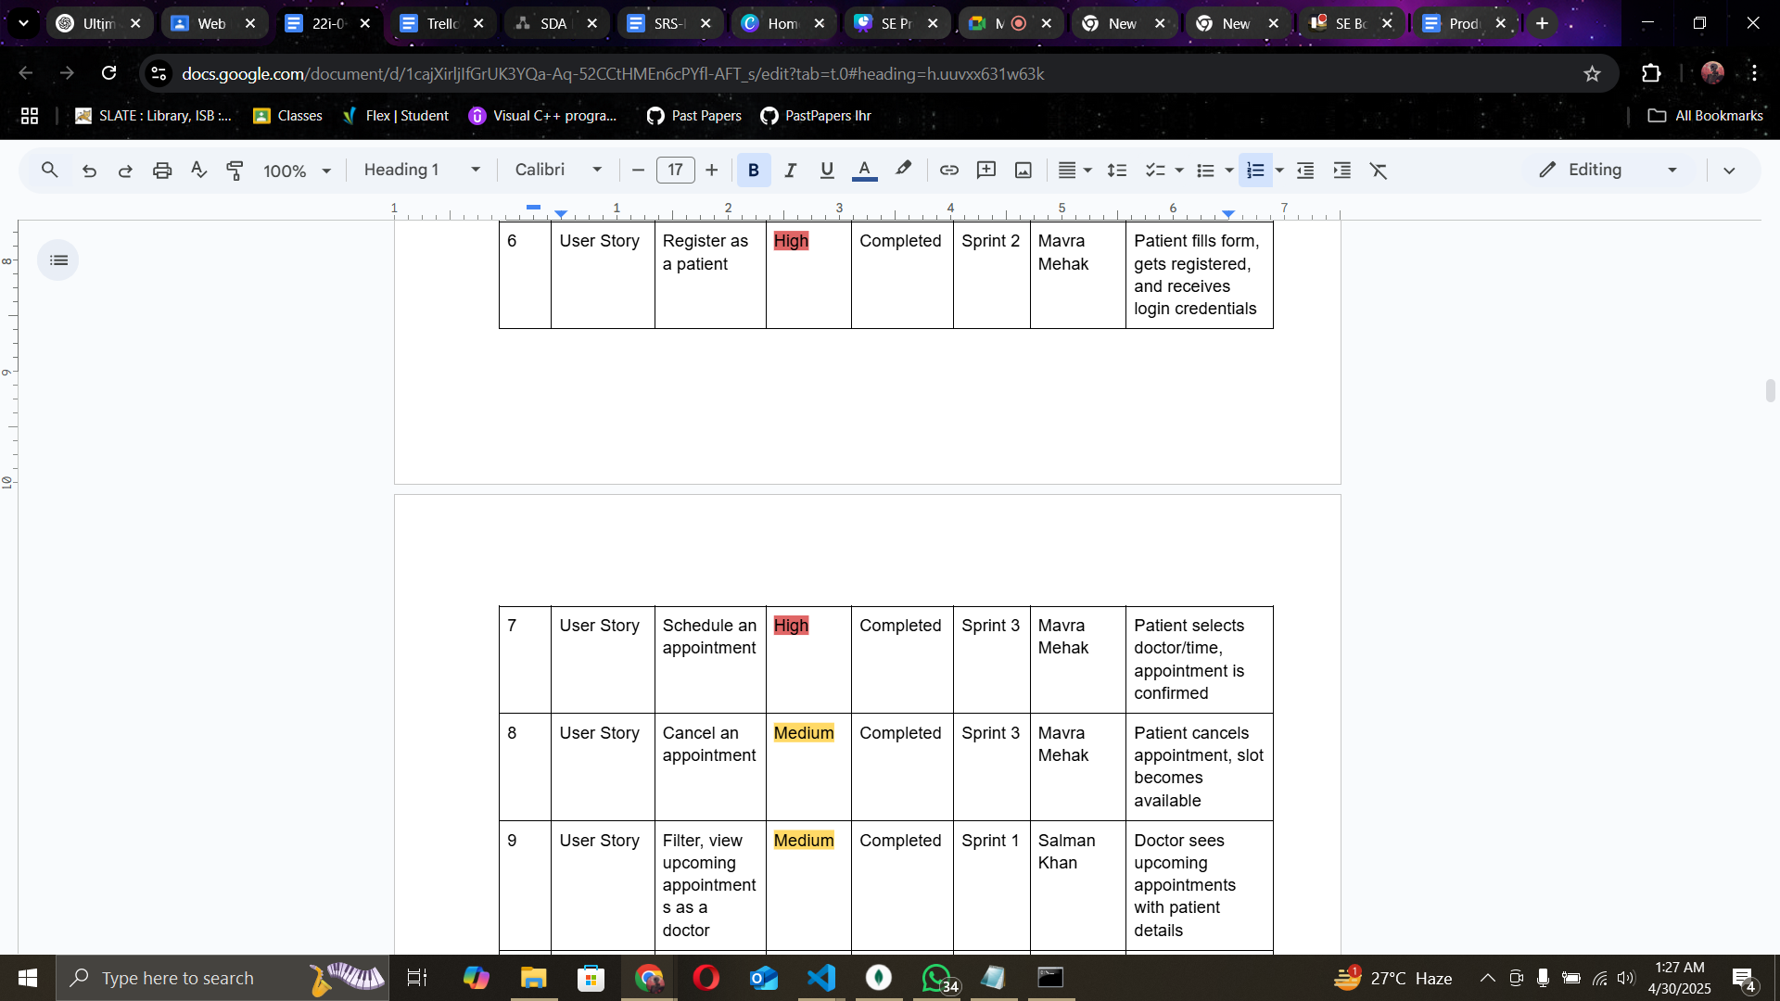
Product Backlog Snippets

Slide 21
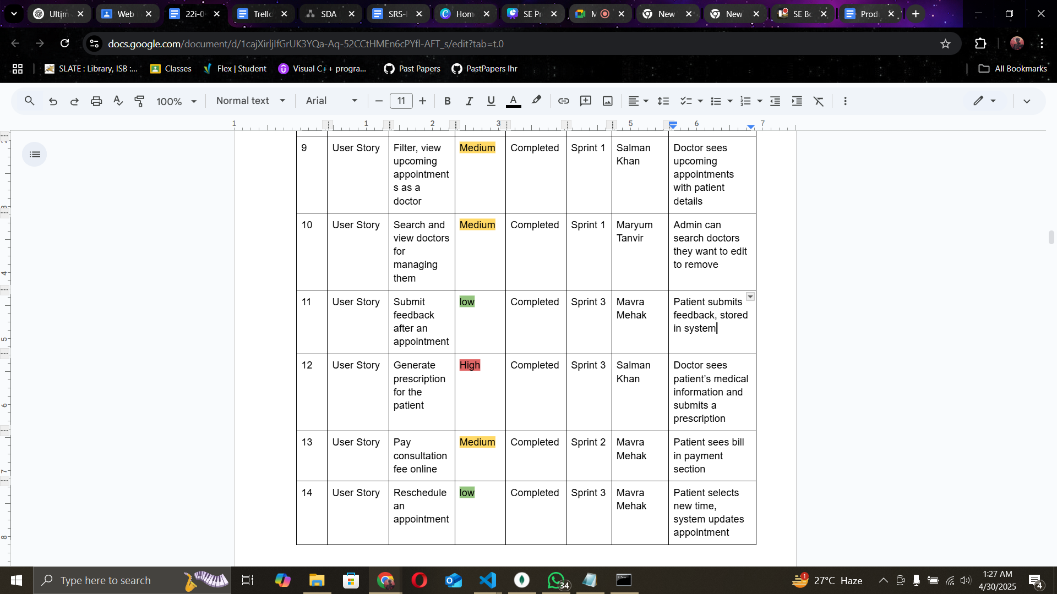
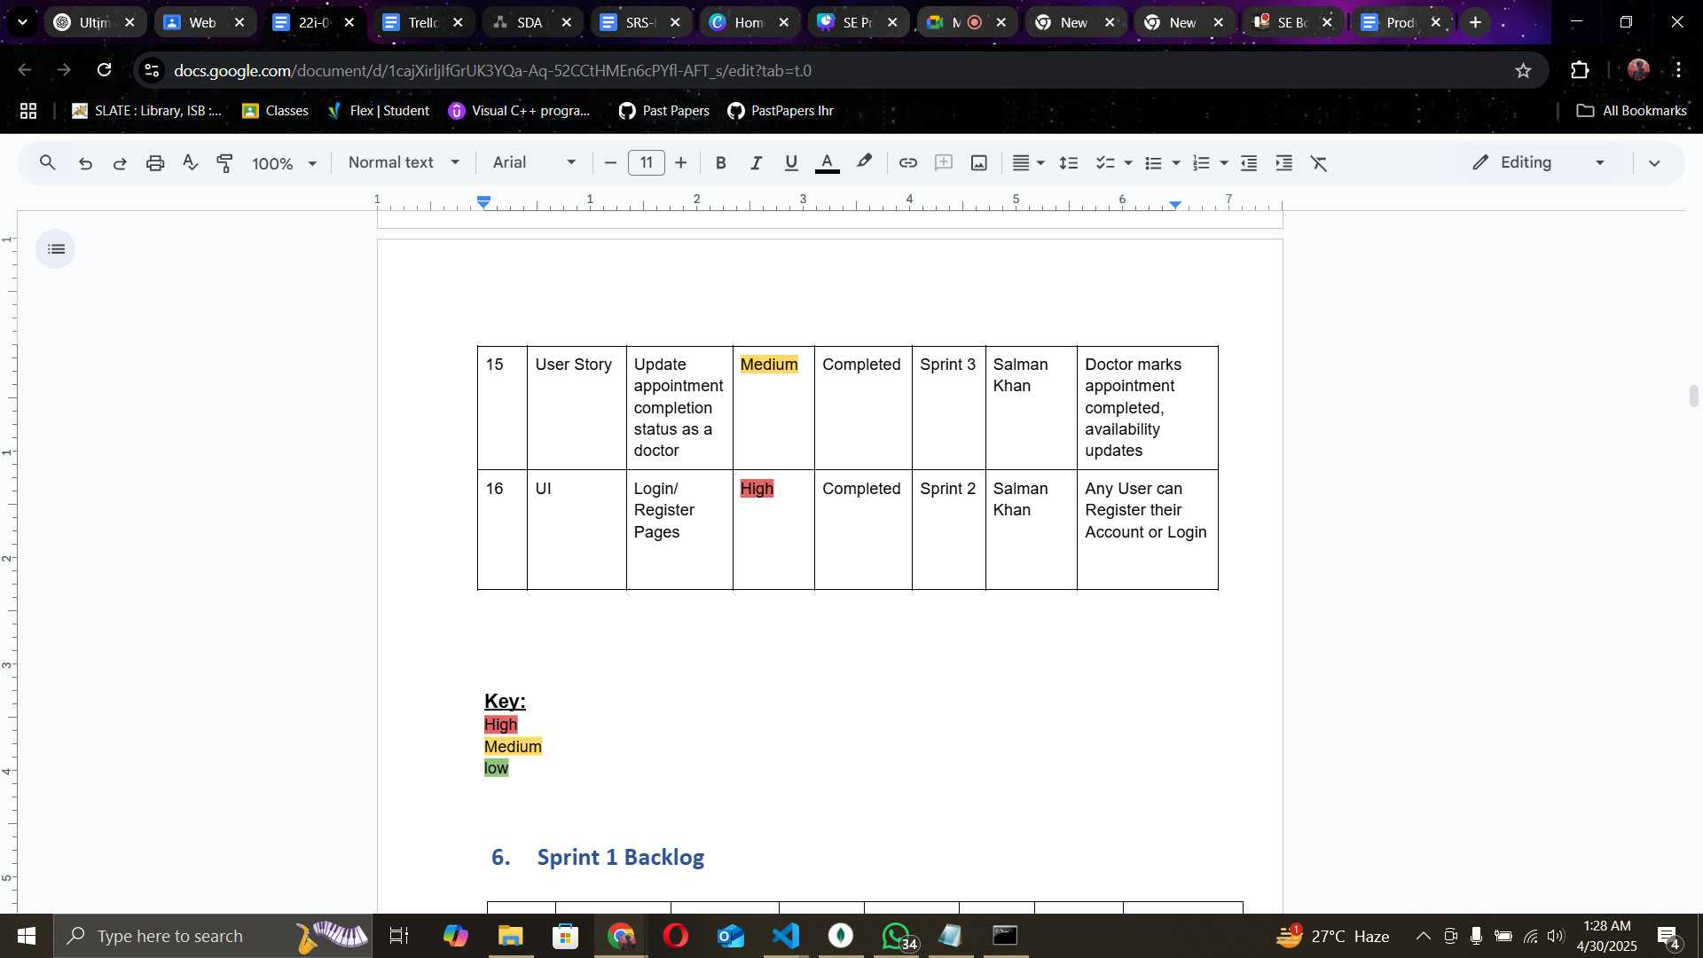
Product Backlog Snippets

Slide 22
Black Box

Slide 23
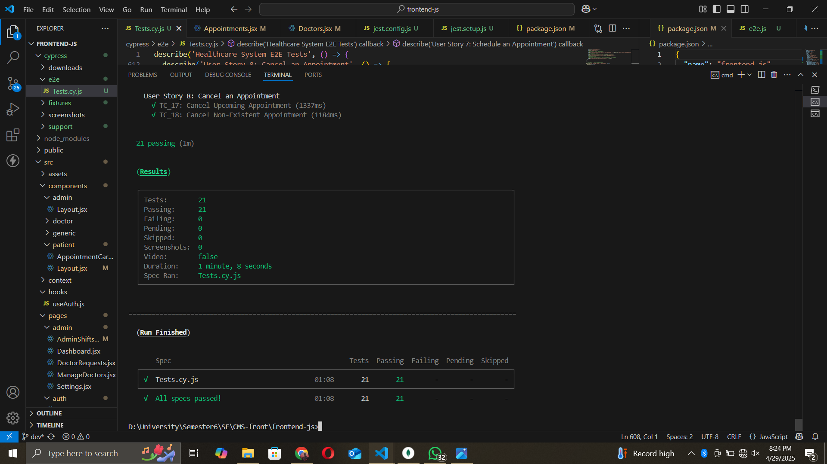

Slide 24
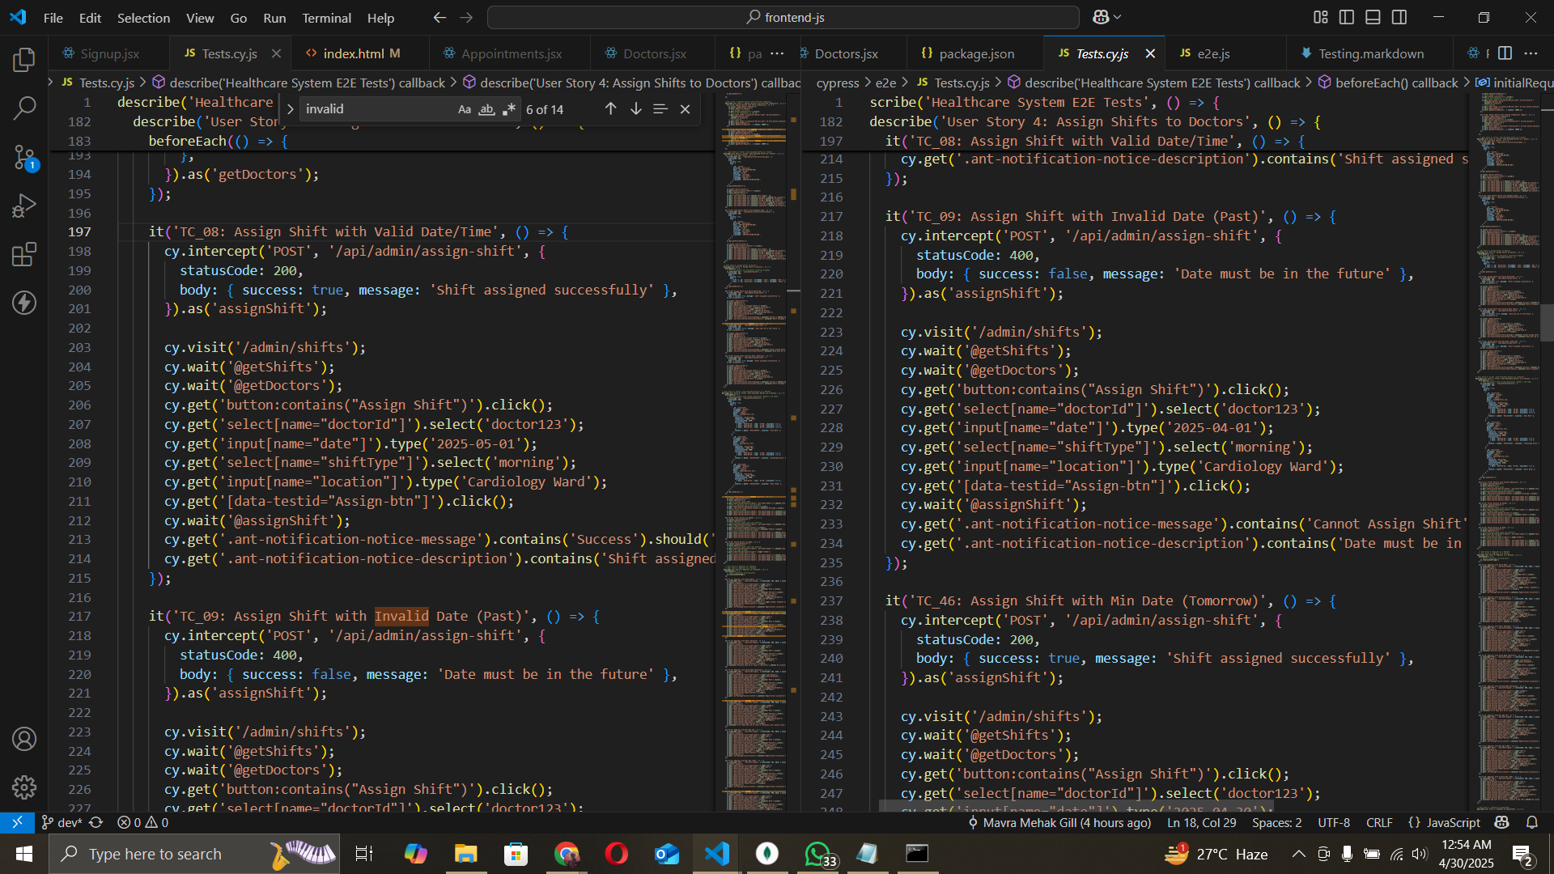
Equivalence Class Partitioning
Notes:
ECP divides the input domain into partitions or classes where the system is expected to behave similarly. Each partition represents a set of inputs that should produce the same output or behavior.
Used to partition inputs like specialty (TC_11), gender (TC_49), and email (TC_13) into valid and invalid classes.
Ensures the system handles representative inputs correctly, reducing test cases while covering key scenarios.
Example: Filtering by Oncology (invalid specialty) ensures no doctors are shown, testing the invalid partition.

Slide 25
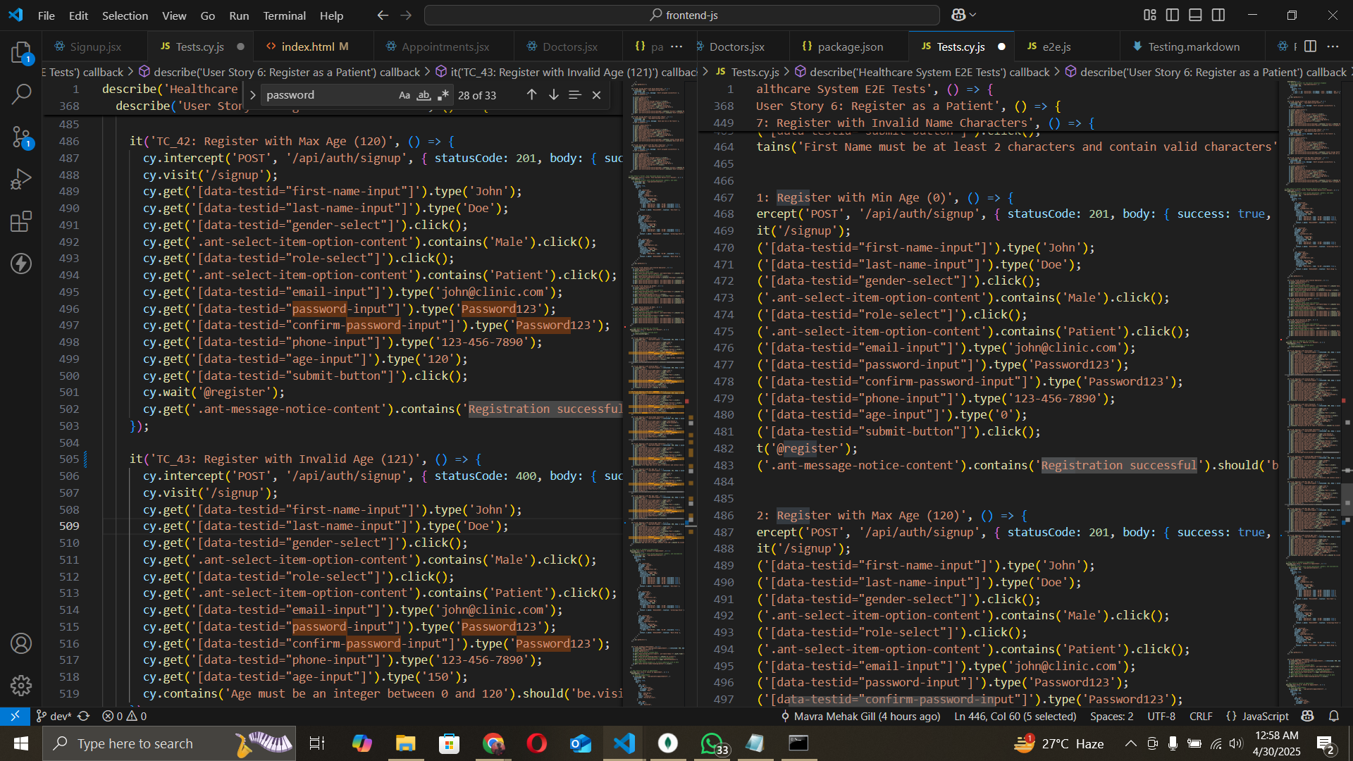
Boundary Value Analysis
Notes:
BVA is a black-box testing technique that focuses on testing the boundaries or edge cases of input domains, where defects are most likely to occur. It assumes that errors are more common at the boundaries of input ranges rather than in the middle. For a numeric input like age, BVA tests:
Boundary values: The exact minimum and maximum values of the valid range.
Just outside boundaries: Values immediately below the minimum and above the maximum.
Just inside boundaries: Values immediately above the minimum and below the maximum.

Slide 26
White Box

Slide 27
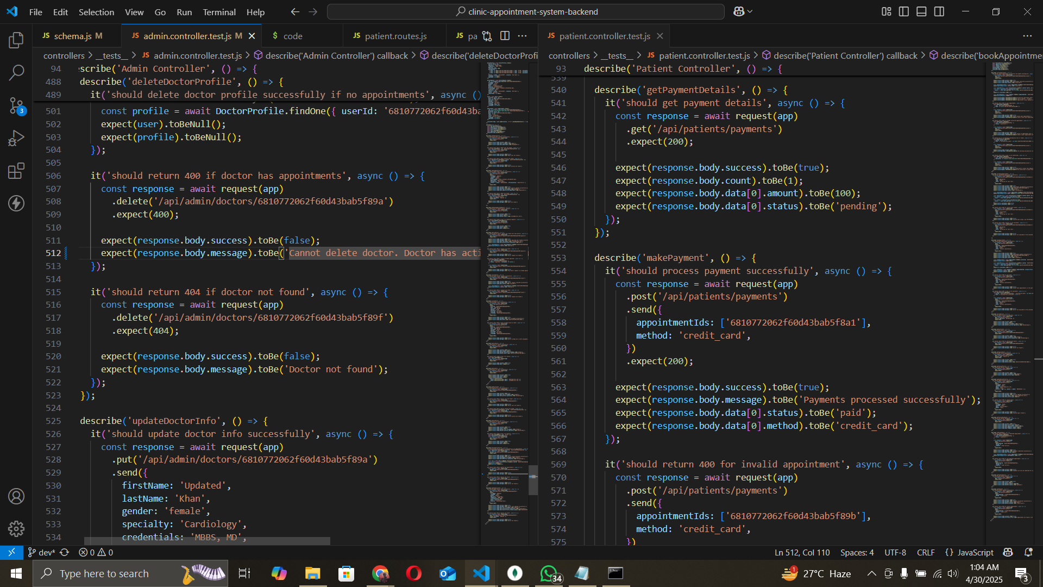
Unit Testing
Notes:
BVA is a black-box testing technique that focuses on testing the boundaries or edge cases of input domains, where defects are most likely to occur. It assumes that errors are more common at the boundaries of input ranges rather than in the middle. For a numeric input like age, BVA tests:
Boundary values: The exact minimum and maximum values of the valid range.
Just outside boundaries: Values immediately below the minimum and above the maximum.
Just inside boundaries: Values immediately above the minimum and below the maximum.

Slide 28
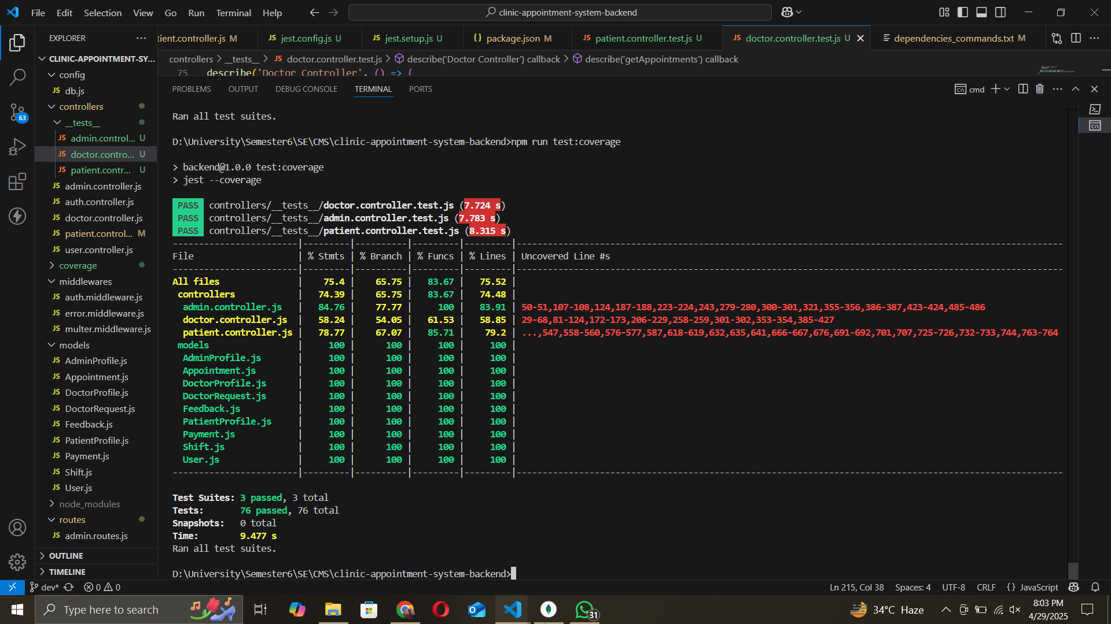
Coverage Report
Notes:
BVA is a black-box testing technique that focuses on testing the boundaries or edge cases of input domains, where defects are most likely to occur. It assumes that errors are more common at the boundaries of input ranges rather than in the middle. For a numeric input like age, BVA tests:
Boundary values: The exact minimum and maximum values of the valid range.
Just outside boundaries: Values immediately below the minimum and above the maximum.
Just inside boundaries: Values immediately above the minimum and below the maximum.

Slide 29
UI

Slide 30
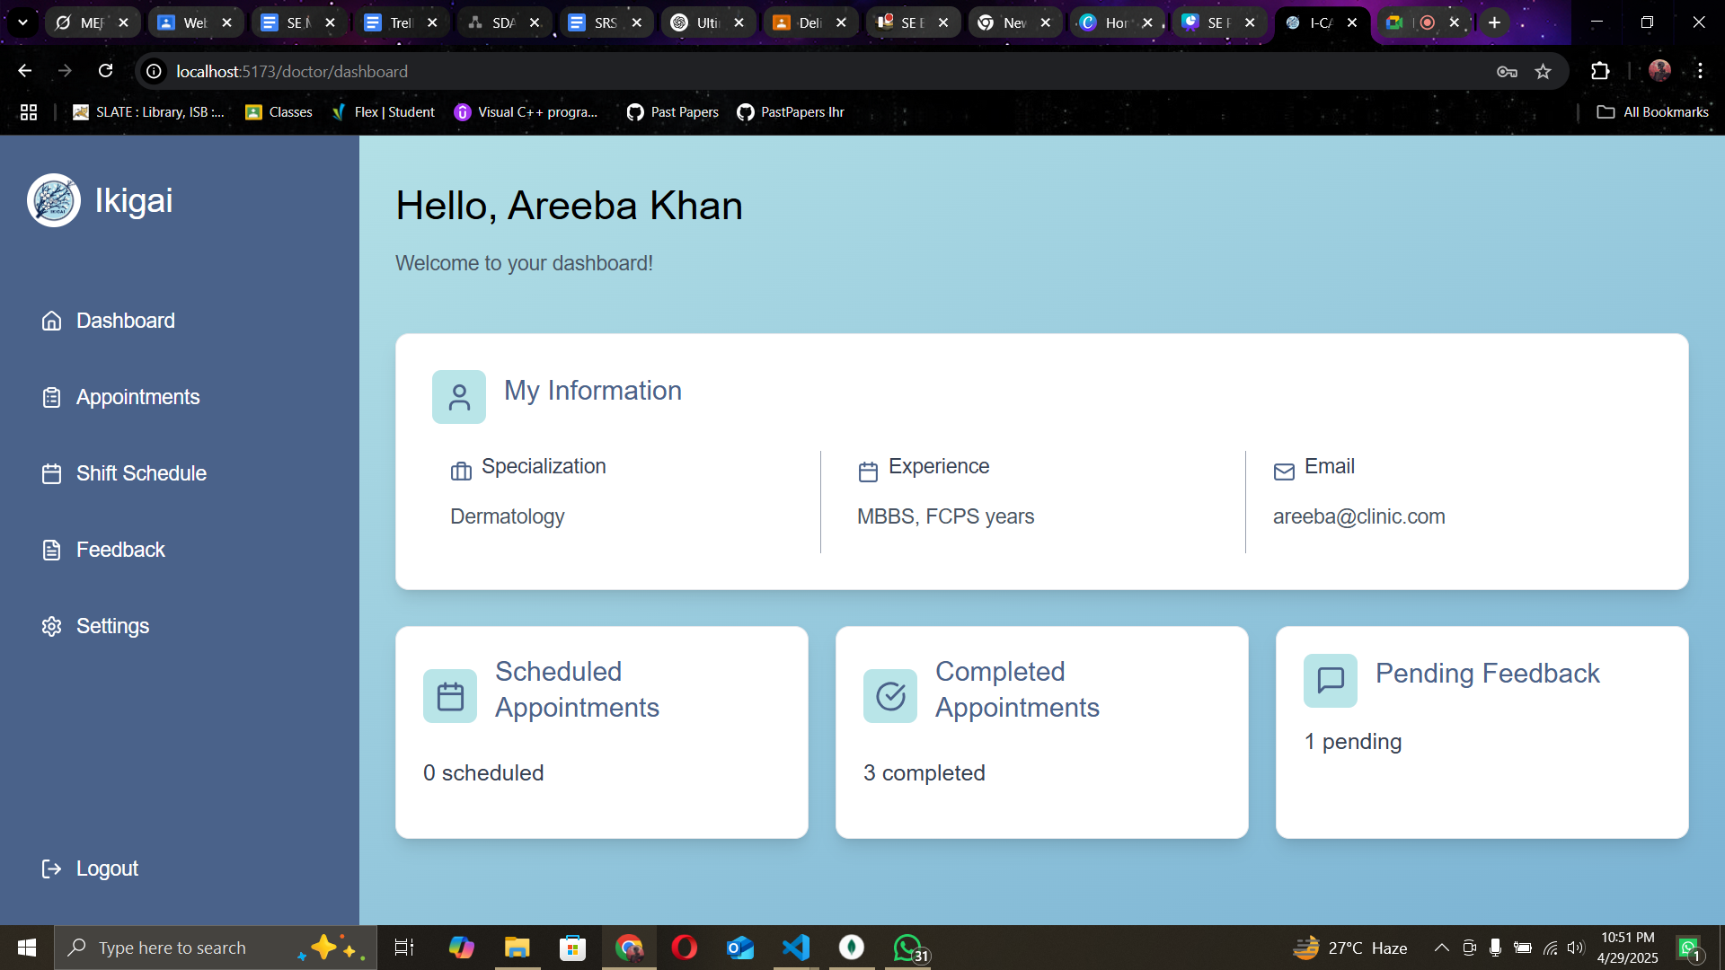
Doctor Dashboard

Slide 31
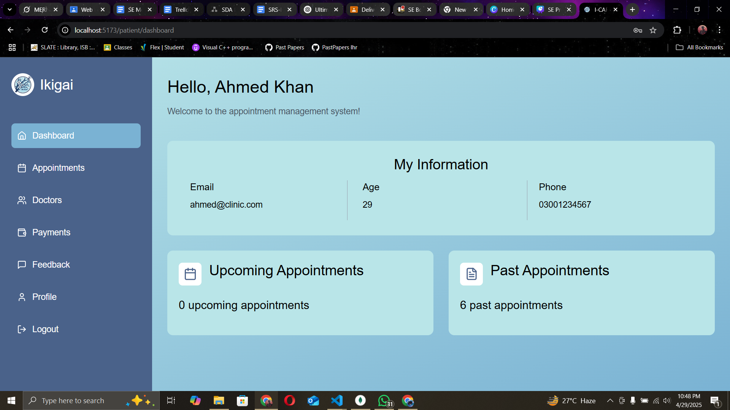
Patient Dashboard

Slide 32
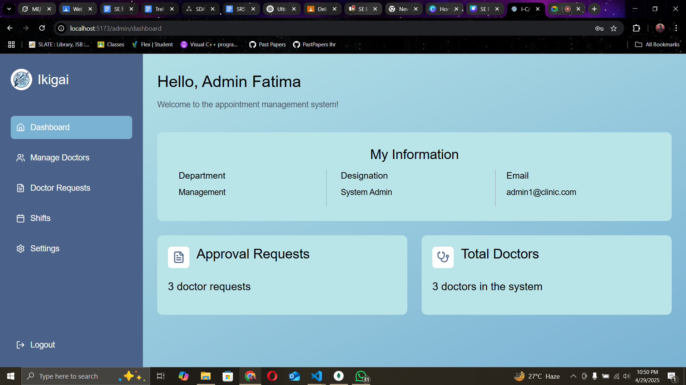
Admin Dashboard

Slide 33
Further Improvements

Slide 34
Test Coverage
The Tests made right now do not cover all of the functionlaities the project has to offer
Impact: Potential bugs in untested areas
Improvements:
Add more testcases
Edge testcases
Notes:
BVA is a black-box testing technique that focuses on testing the boundaries or edge cases of input domains, where defects are most likely to occur. It assumes that errors are more common at the boundaries of input ranges rather than in the middle. For a numeric input like age, BVA tests:
Boundary values: The exact minimum and maximum values of the valid range.
Just outside boundaries: Values immediately below the minimum and above the maximum.
Just inside boundaries: Values immediately above the minimum and below the maximum.

Slide 35
2. Performance Optimization
System may not scale for high appintment volumes.
Impact: Slow queries, more lag and loading.
Improvements:
MongoDB Indexes
Dealing with storagr issue
Notes:
BVA is a black-box testing technique that focuses on testing the boundaries or edge cases of input domains, where defects are most likely to occur. It assumes that errors are more common at the boundaries of input ranges rather than in the middle. For a numeric input like age, BVA tests:
Boundary values: The exact minimum and maximum values of the valid range.
Just outside boundaries: Values immediately below the minimum and above the maximum.
Just inside boundaries: Values immediately above the minimum and below the maximum.

Slide 36
Thank you very much!

